Slide 1
Inference of Technical Data from CCTV Images
Laura Su
Schlumberger Cambridge Research

Slide 2
Agenda
Introduction
Objectives
Steps
Data preparation
Model training and COCO metrics
Predictions
Results and analysis
Conclusion

Slide 3
Introduction
In Well construction operations, productive time is split between:
On-bottom time (drilling)
Flat time (necessary steps to be carried out)
Flat time duration depends on human factors and local procedure.
Currently, no automated ways to measure adherence to local procedure and human performance factors.
Opportunity to use CCTV images as source of data to extract for technical/performance indicators.

Slide 4
Objectives
Using object detection on CCTV images to extract flat time and ultimately improve efficiency on the rig.
Hypothesis: The density of people on the rig floor at a given time is a proxy for flat time.

Slide 5
Steps
Data preparation and pre-processing
Predictions
Training a model
Tuning the hyperparameters
Data augmentation
Resizing the PIL images, convert to RGB
Extract frames from videos
Boxes with labels and “objectness” scores
Non maximum suppression
Score threshold
Processing the results
Eliminating the duplicate boxes generated by the model
Plotting density/number of people vs time
Analysis and comparison with conventional drilling data
Labelling the frames (labelImg)
Outputting the results as a data frame (dataiku)
Supervised learning
Normalizing the images
Neural network

Slide 6
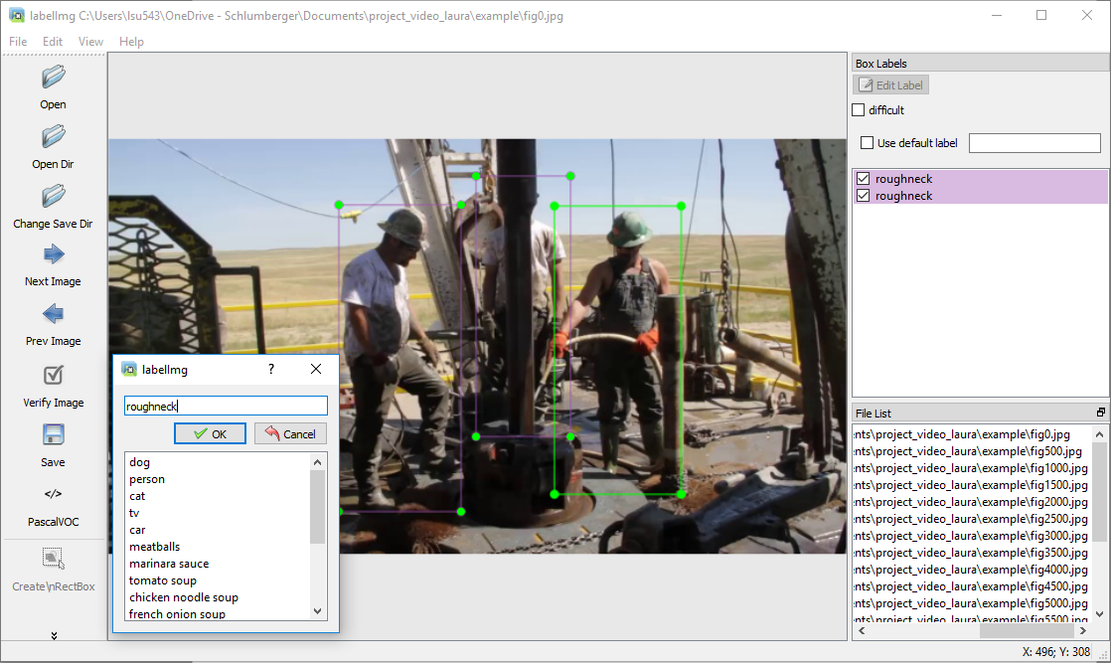
Data preparation
Dataset: 632 images
Training will be done on Schlumberger data
Example on public data
(Youtube)

Slide 7
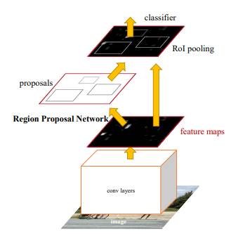
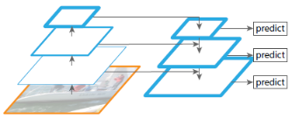
Model training: neural network
Faster R-CNN (with ResNet50)
FPN
Feature Pyramid Network, source: https://towardsdatascience.com/review-fpn-feature-pyramid-network-object-detection-262fc7482610
Faster R-CNN architecture, source: https://arxiv.org/pdf/1506.01497.pdf
Notes:
Faster R-CNN: CNN for both region proposal generation and object detection tasks.
Regions proposals are reshaped with the RoI pooling layer.
Result used to classify image with the proposed regions and predict box coordinates.
FPN: combines low and high resolutions (“semantically weak features” and “semantically strong features”)
Improves accuracy and speed

Slide 8
Model training: transfer learning
Used: Faster R-CNN with ResNet50 backbone and FPN, pre-trained on COCO dataset
Done for 2 classes only (background and people)
Why transfer learning?
Training from scratch requires quite a big dataset and can be time consuming
Good model with a limited dataset
A pre-trained model is already available
Saving time and getting a potentially better performance

Slide 9
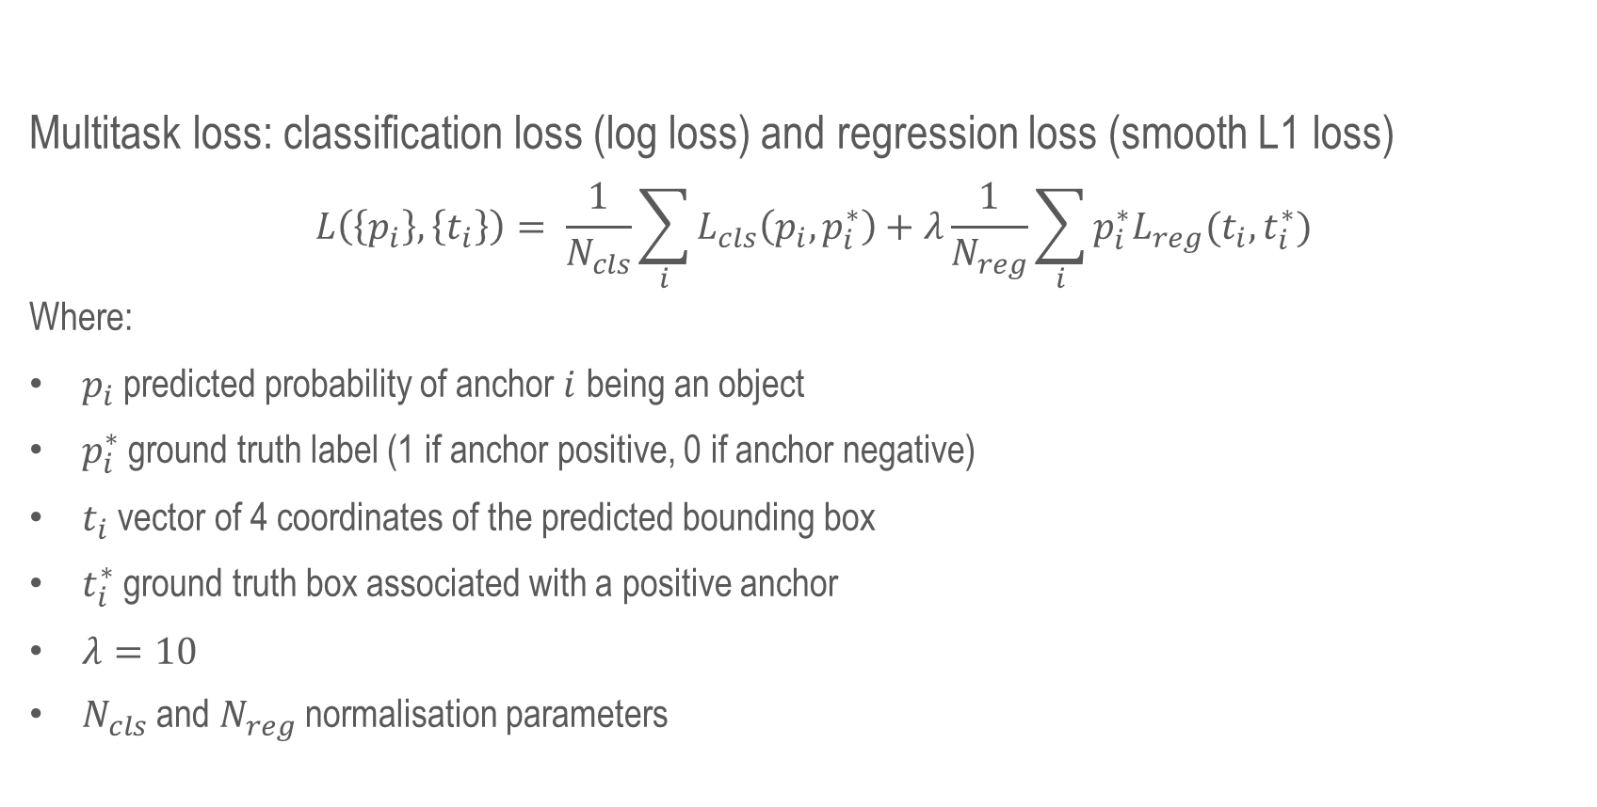
Loss function
Multitask loss: classification loss (log loss) and regression loss (smooth L1 loss)
$$L\left(\left\{p_{i}\right\}, \left\{t_{i}\right\}\right)= \frac{1}{N_{cls}}\sum_{i}{L_{cls}\left(p_{i}, p_{i}^{∗}\right)+λ\frac{1}{N_{reg}}\sum_{i}{p_{i}^{∗}L_{reg}(t_{i}, t_{i}^{∗})}}$$
Where:
$p_{i}$ predicted probability of anchor $i$ being an object
$p_{i}^{∗}$ ground truth label (1 if anchor positive, 0 if anchor negative)
$t_{i}$ vector of 4 coordinates of the predicted bounding box
$t_{i}^{∗}$ ground truth box associated with a positive anchor
$λ=10$
$N_{cls}$ and $N_{reg}$ normalisation parameters

Slide 10
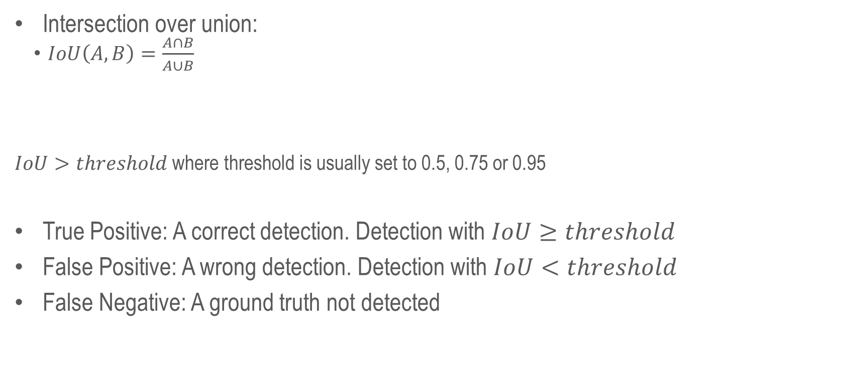
COCO metrics
Intersection over union:
$IoU\left(A, B\right)=\frac{A∩B}{A∪B}$
$IoU>threshold$ where threshold is usually set to 0.5, 0.75 or 0.95
True Positive: A correct detection. Detection with $IoU≥threshold$
False Positive: A wrong detection. Detection with $IoU<threshold$
False Negative: A ground truth not detected

Slide 11
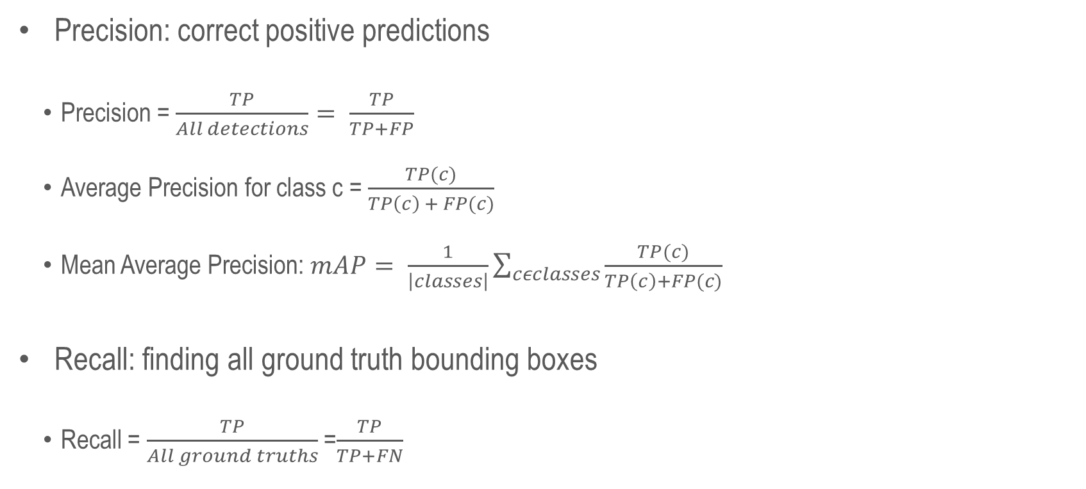
COCO metrics
Precision: correct positive predictions
Precision =$\frac{TP}{All detections}= \frac{TP}{TP+FP}$
Average Precision for class c = $\frac{TP(c)}{TP\left(c\right) + FP(c)}$
Mean Average Precision: $mAP= \frac{1}{\left|classes\right|}\sum_{cεclasses}{\frac{TP(c)}{TP\left(c\right)+FP(c)}}$
Recall: finding all ground truth bounding boxes
Recall = $\frac{TP}{All ground truths}$ =$\frac{TP}{TP+FN}$

Slide 12
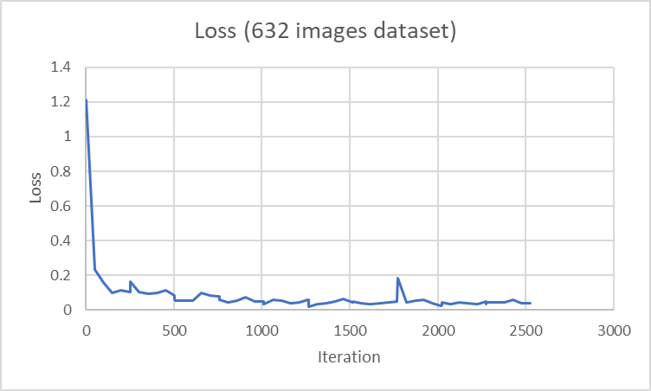
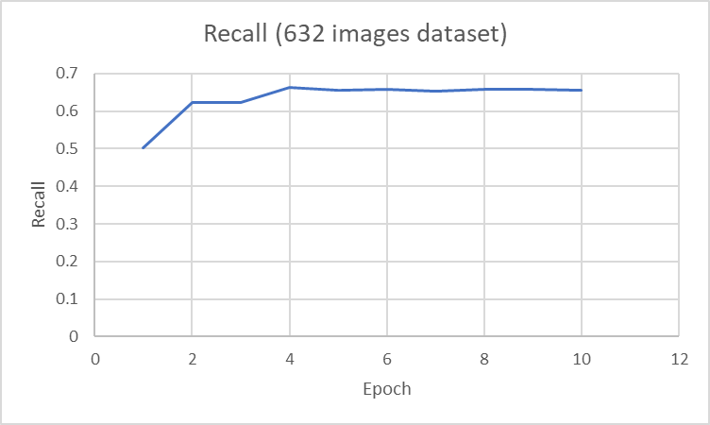
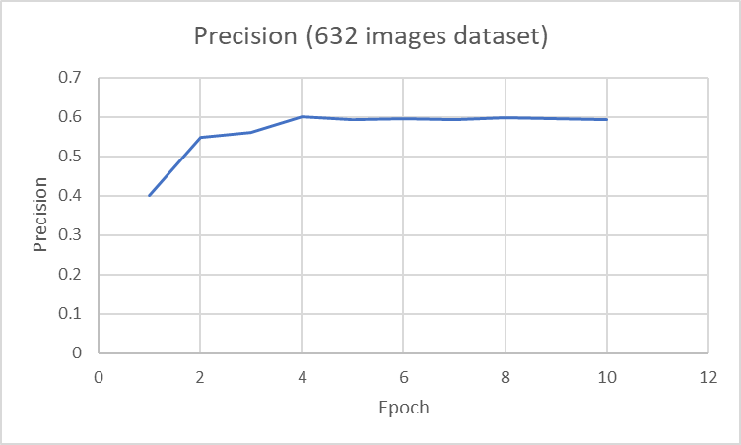
Model training

Slide 13
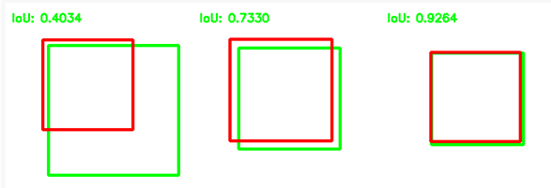
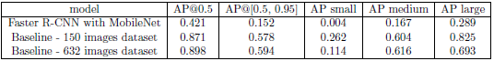
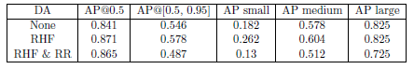
Model training: some metrics
Trying a different backbone, and comparing with 2 datasets
Data augmentation
IoU representation:
AP: average precision
Small – medium – large: box area/size
Source: https://www.pyimagesearch.com/2016/11/07/intersection-over-union-iou-for-object-detection/

Slide 14
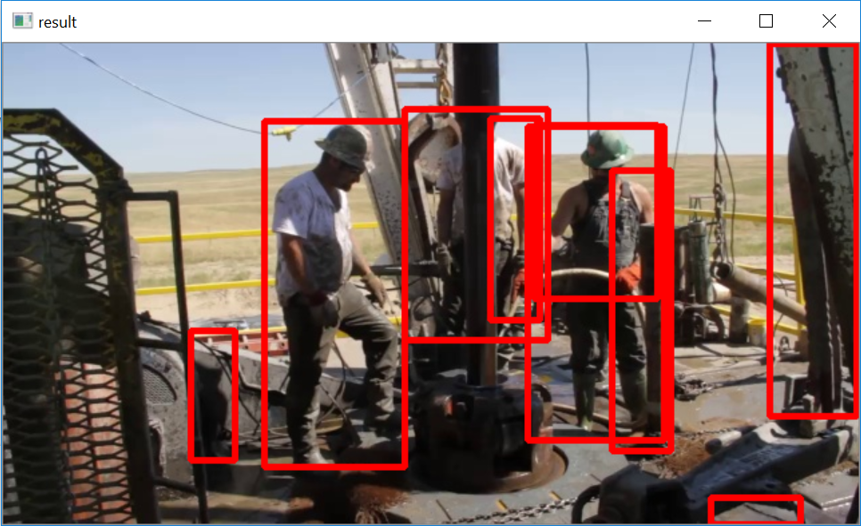
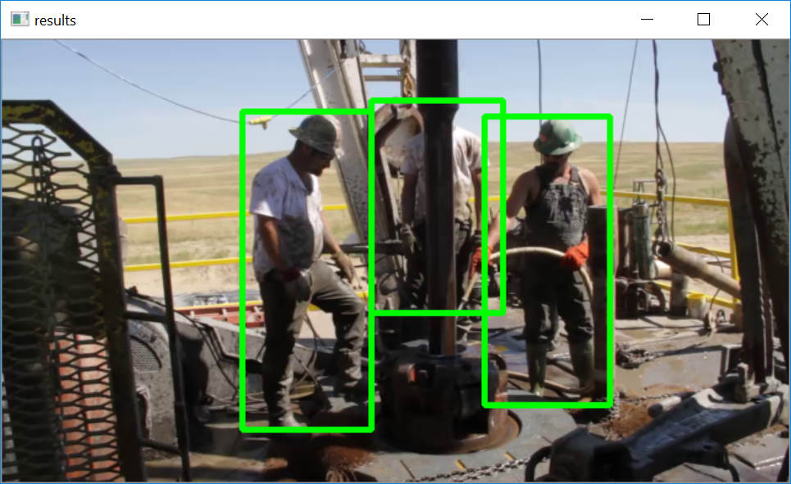
Predictions
Non-maximum suppression and score threshold ($score>0.90$)

Slide 15
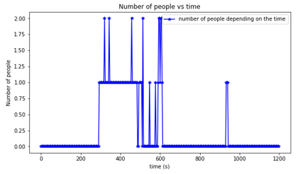
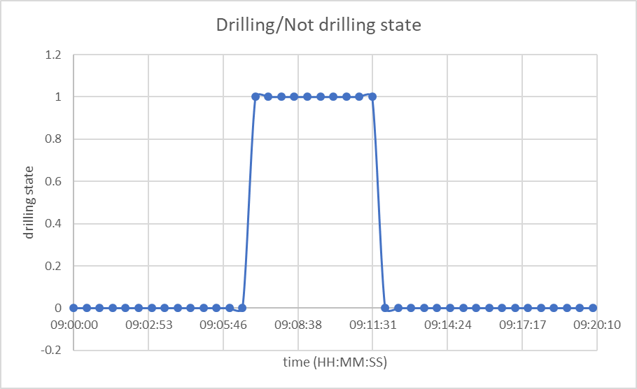
Results and analysis
From the predictions
Calculated from conventional drilling data

Slide 16
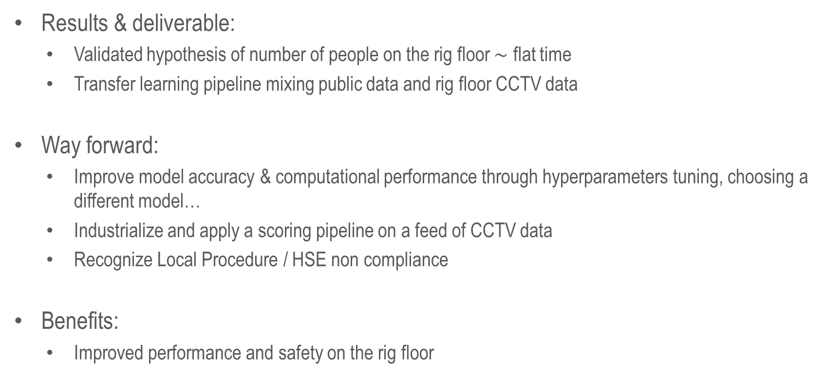
Conclusion
Results & deliverable:
Validated hypothesis of number of people on the rig floor $\sim$ flat time
Transfer learning pipeline mixing public data and rig floor CCTV data
Way forward:
Improve model accuracy & computational performance through hyperparameters tuning, choosing a different model…
Industrialize and apply a scoring pipeline on a feed of CCTV data
Recognize Local Procedure / HSE non compliance
Benefits:
Improved performance and safety on the rig floor

Slide 17
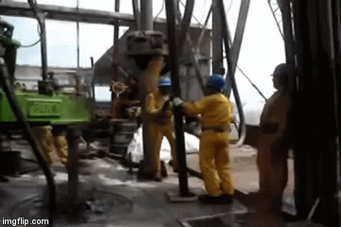
Thank you for you attention.
Any questions?

